Slide 1
3x3 Orient Last Layer and Permute Last Layer
COLL 134
Week 5

Slide 2
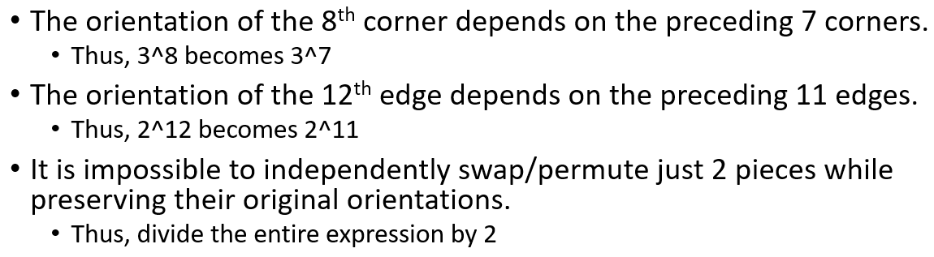
Return to Cube Theory
Recall from Week 1: only 1/12 of all possible cube states are “legal”

Slide 3
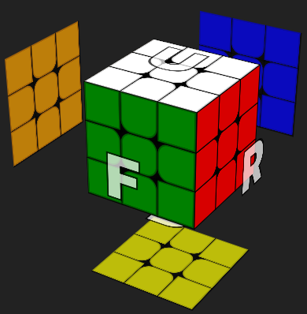
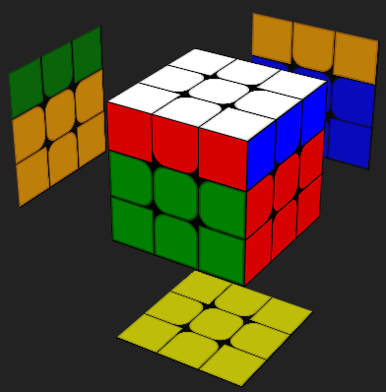
Swaps:
Consider the simplest possible move: a 90º face turn (e.g. U)
#1
#1
#2
3 corner swaps
+ 3 edge swaps
= 6 total swaps
#2
#3
#3

Slide 4
Swaps:
The simplest move performs an even number of swaps
= It is impossible to perform an odd number of swaps

Slide 5
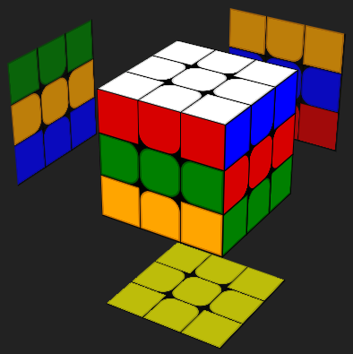
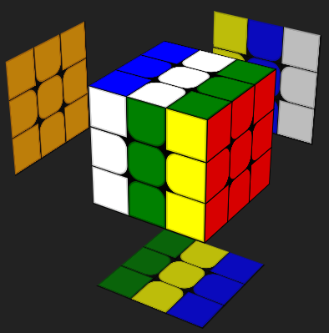
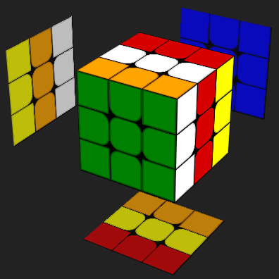
EO:
Suppose the frame of reference for EO is U/D and F/B.
Any 2 out of 3 of the opposing face pairs will span all 12 edges.
U/D and F/B moves flip zero edges
R/L moves flip four edges

Slide 6
EO:
The simplest moves perform either zero or four edge flips.
= It is impossible to perform an odd number of edge flips.
Even # of E1-10 are flipped: Odd # of E1-10 are flipped:
- E11 flipped = E12 flipped - E11 flipped = E12 not flipped
- E11 not flipped = E12 not flipped - E11 not flipped = E12 flipped

Slide 7
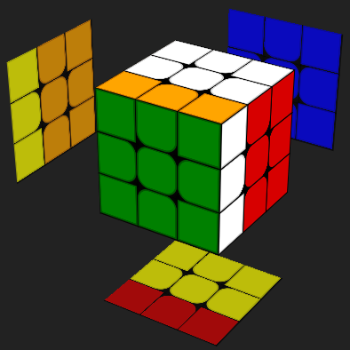
CO:
Suppose the frame of reference for CO is U/D.
Any 1 out of 3 of the opposing face pairs will span all 8 corners.
Assign CO values:
0 = correct CO
1 = clockwise CO
2 = counterclockwise CO
Counterclockwise CO = 2
Clockwise CO = 1
F/D and R/L moves twist corners such that CO sum = 6.
SUM: 2 + 1 + 1 + 2 = 6
U/D moves do not twist corners.
Clockwise CO = 1
Counterclockwise CO = 2

Slide 8
CO:
The simplest moves perform corner twists,
such that the CO sum is always divisible by 3.
= It is impossible to reach states where the CO sum is indivisible by 3.
CO sum for C1-7 = 3n → C8 is correctly oriented
CO sum for C1-7 = 3n+1 → C8 has a counterclockwise CO
CO sum for C1-7 = 3n+2 → C8 has a clockwise CO
(n is an integer)

Slide 9
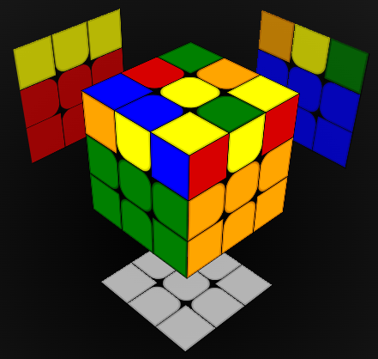
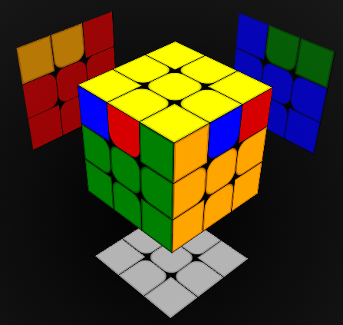
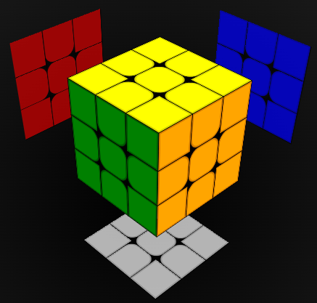

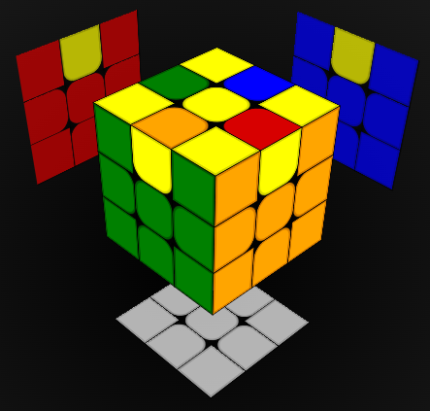
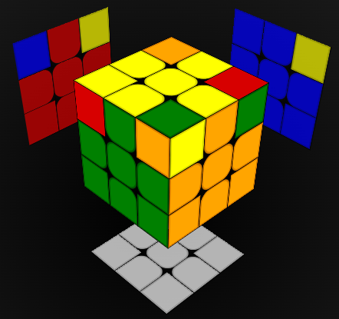
Last Layer Terminology
OLL = orient last layer
Place all corners and edges in correct orientation
PLL = permute last layer
Place all corners and edges in correct position
CLL = corners of last layer
Simultaneously orient and permute corners
ELL = edges of last layer
Simultaneously orient and permute edges
n-Look (usually, 1 ≤ n ≤ 4)
Solve in n steps

Slide 10
Solving Last Layer
Mostly dependent on algorithms
See reference sheets under Canvas Files
2 options for beginners:
4-look OLL-PLL (easy transition to CFOP)
4-look ELL-CLL (fewer algorithms)
Only 1 viable option for speedsolvers: 2-look OLL-PLL
2-look ELL-CLL cases are much harder to recognize

Slide 11
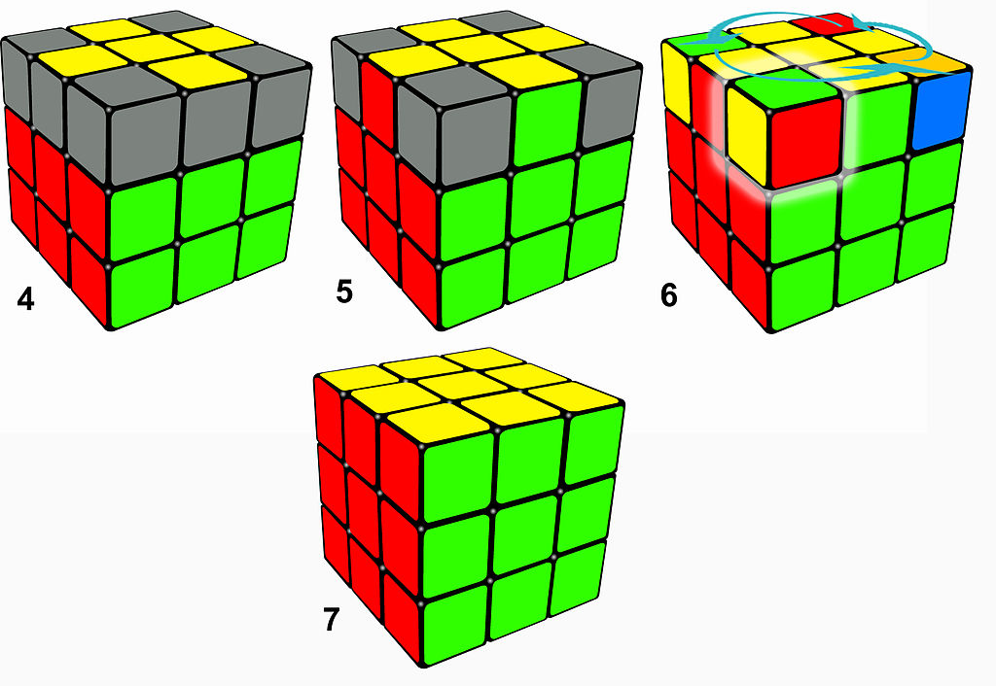
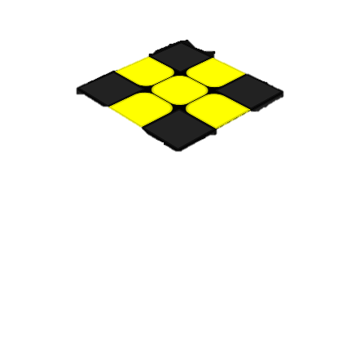
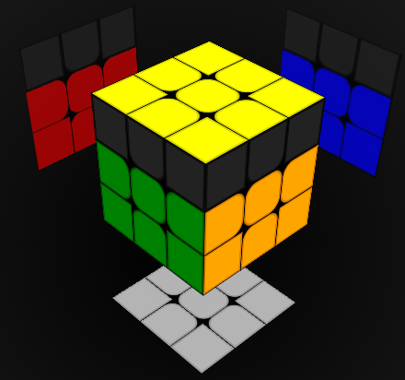
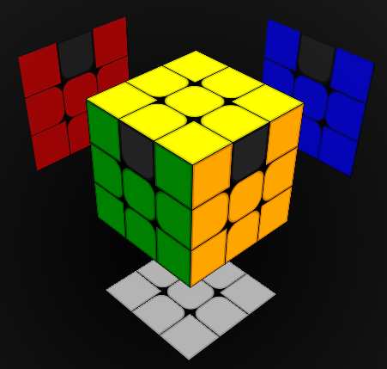
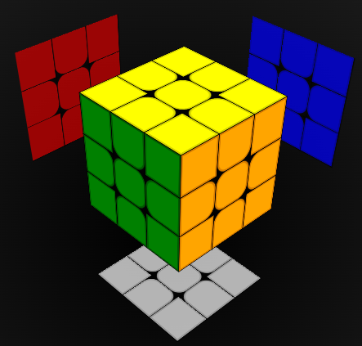
4-Look Steps
ELL/CLL:
OLL/PLL
Step 1 (EOLL): orient edges
Step 2 (COLL): orient corners
Step 3 (CPLL): permute corners
Step 4 (EPLL): permute edges
ELL/CLL
Step 1: orient edges
Step 2: permute edges
Step 3: permute corners
Step 4: orient corners
OLL/PLL:

Slide 12
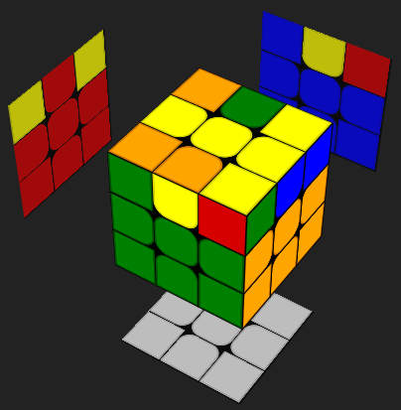
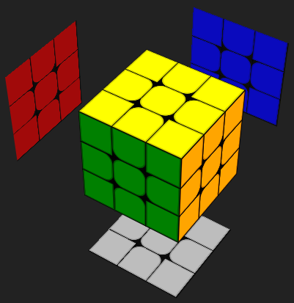
OLL Example 1: Bar → Yellow Cross
Algorithm: F (R U R’ U’) F’
 | C1 | E1 | C2
 | E4 |  | E2
 | C4 | E3 | C3
 | C2 | E2 | C1
 | E4 |  | E3
 | C3 | E1 | C4
Swaps Rule: C1-C2, C3-C4, E1-E2 → E1-E3 (4 total swaps)
EO Rule: E1 and E3 flipped (2 flipped edges)
CO Rule: 1 + 0 + 0 + 2 = 3 (CO sum divisible by 3)

Slide 13
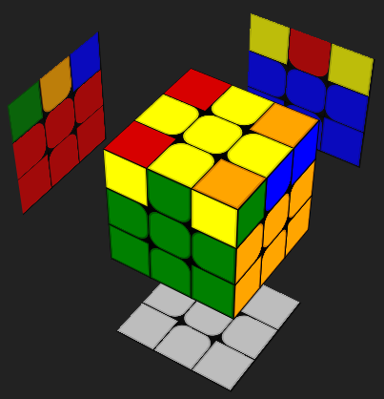
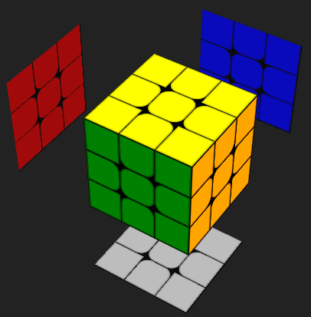
OLL Example 2: Double Headlights
Algorithm: (R U2 R’ U’) (R U R’ U’) (R U’ R’)
 | C1 | E1 | C2
 | E4 |  | E2
 | C4 | E3 | C3
 | C1 | E2 | C2
 | E1 |  | E4
 | C4 | E3 | C3
Swaps Rule: E1-E4 → E2-E4 (2 total swaps)
EO Rule: 0 flipped edges
CO Rule: 2 + 1 + 2 + 1 = 6 (CO sum divisible by 3)

Slide 14
Algorithm Proficiency
Know correct positioning
Practice case recognition

Slide 15
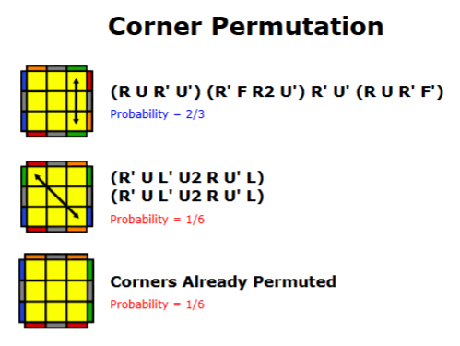
CPLL Recognition
3 possibilities:
Swap adjacent corners
- Look for headlights
Swap opposite corners
- No headlights
Do nothing (corners solved)
- Headlights on all 4 sides

Slide 16
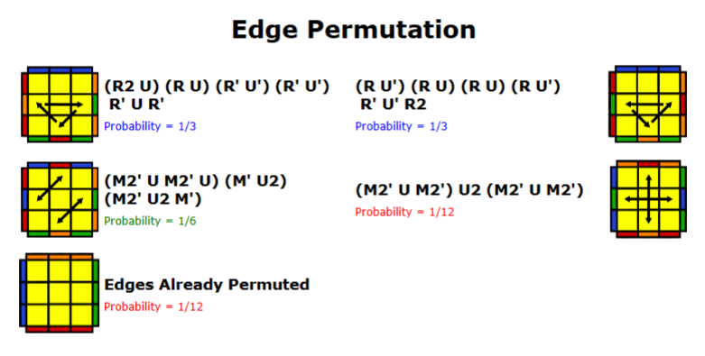
EPLL Recognition
5 possibilities:
Three edges
Cycle clockwise (Ub)
Cycle counterclockwise (Ua)
Four edges
Swap 2 adjacent pairs (Z)
Swap 2 opposite pairs (H)
5. Do nothing

Slide 17
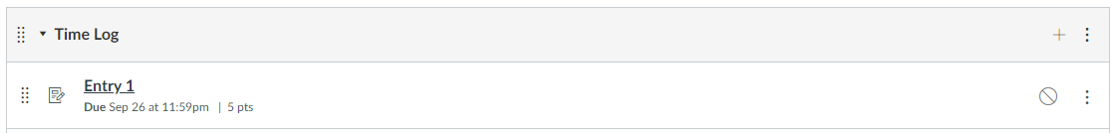
Solve Time Log
Weekly entries
5 timed solves

Slide 18
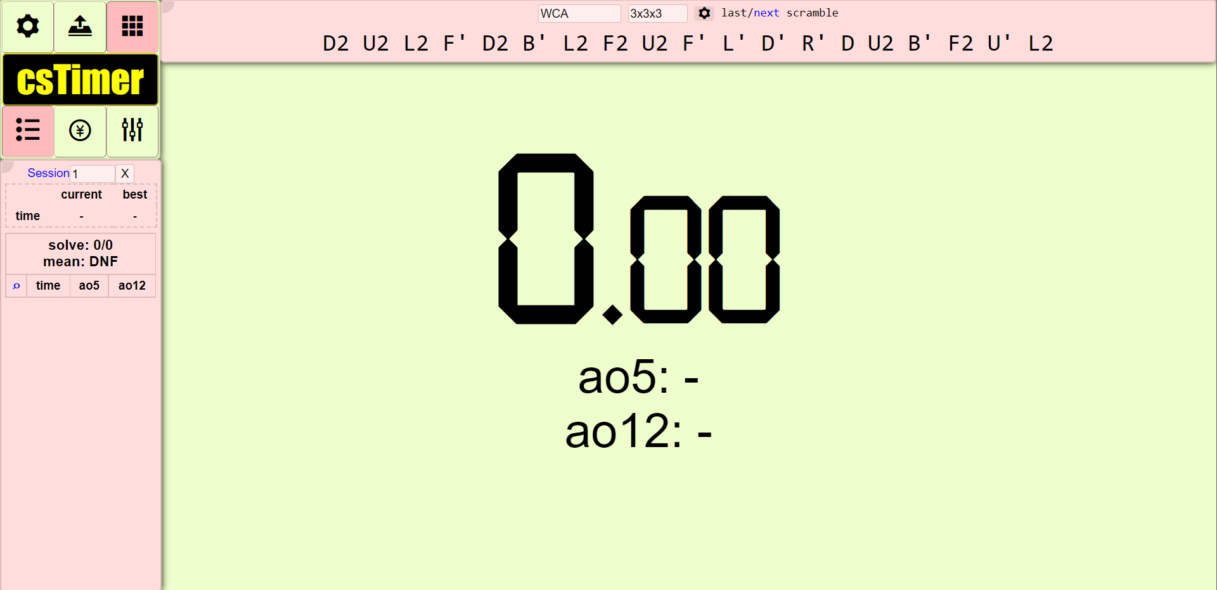
csTimer
cstimer.net
Multipurpose solve timer – tons of functions and customization

Slide 19
Mobile Timers
Clock app
iOS – ChaoTimer or SkipTimer
Android – Twisty Timer

